Slide 1

Netflix Data Engineering Pipeline: ETL and Analytics System
Department of CSE
COURSE: FUNDAMENTALS OF DATA ENGINEERING – (24DEA3101)
SECTION-4
Review-1
Team-10
Under the Guidance of: DR.N Shirisha
Team Members
2420030332-K.Bhavana
2420030471-N.Nikitha Reddy
2420030119-C.Akshara

Slide 2
ABSTRACT
The Netflix Data Engineering Pipeline: ETL and Analytics System is a proposed end-to-end data engineering project that aims to process and analyze Netflix movies and TV shows data using an ETL (Extract, Transform, Load) pipeline. The project will focus on converting raw Netflix data into structured and meaningful information through data extraction, cleaning, transformation, storage, analysis, and visualization.
The Netflix dataset containing approximately 8,807 records will be processed using Python and Pandas. The raw data will be cleaned to handle missing values, remove inconsistencies, and prepare it for further analysis. The transformed data will then be stored in a MySQL database, where SQL queries will be used to analyze content type, country, release year, ratings, and genres.
Finally, the processed data will be connected to Microsoft Power BI to develop an interactive dashboard that will present insights such as the distribution of movies and TV shows, top content-producing countries, release-year trends, and rating distribution. This project is expected to demonstrate a complete ETL workflow and provide practical experience in modern data engineering and analytics.

Slide 3
INTRODUCTION
In today's digital world, organizations generate and collect large amounts of data from various sources. However, raw data often contains missing values, inconsistent information, and unstructured records, making it difficult to analyze. Data engineering plays an important role in collecting, cleaning, transforming, storing, and preparing data for analysis and decision-making.
Netflix, one of the world's leading streaming platforms, provides a rich dataset containing information about movies and TV shows, including title, content type, country, release year, rating, duration, and genre. Analyzing this information can help identify trends and patterns in Netflix's content library.
This project aims to develop an end-to-end Netflix Data Engineering Pipeline using Python, Pandas, MySQL, and Power BI. The project will begin by extracting the Netflix dataset, followed by cleaning and transforming the data using Python. The processed data will then be stored in a MySQL database to enable efficient querying through SQL.
Finally, the database will be connected to Power BI to create an interactive dashboard that will visualize key insights such as the total number of titles, the distribution of movies and TV shows, country-wise content distribution, release-year trends, and rating analysis. Through this project, we aim to gain practical knowledge of the complete data engineering workflow, from raw data ingestion to meaningful business insights.

Slide 4
OBJECTIVES
To develop an end-to-end ETL pipeline for Netflix data.
To extract Netflix data from the raw dataset using Python and Pandas.
To clean and transform the data by handling missing values and inconsistencies.
To store the processed data in a MySQL database.
To perform data analysis using SQL queries.
To visualize Netflix data using an interactive Power BI dashboard.
To identify trends in content type, country, release year, ratings, and genres.

Slide 5
LITERATURE SURVEY
No. | Authors / Year | Paper Title | Methodology | Key Inference | Limitation / Future Work
1 | Gómez-Uribe & Hunt (2015) | The Netflix Recommender System: Algorithms, Business Value, and Innovation | Uses large-scale user interaction data, recommendation algorithms, offline experiments and A/B testing. | Data-driven recommendation systems can improve user engagement and retention. | Requires continuous experimentation and large-scale data processing. (DOI)
2 | Steck et al. (2021) | Deep Learning for Recommender Systems: A Netflix Case Study | Applies deep-learning models to heterogeneous Netflix user and content data for personalized ranking. | Deep learning becomes more effective when diverse features are incorporated into the data pipeline. | Offline and online performance can differ; maintaining large-scale ML pipelines is challenging. (Wiley Online Library)
3 | Nagrecha et al. (2023) | InTune: Reinforcement Learning-based Data Pipeline Optimization for Deep Recommendation Models | Studies real-world Netflix data-ingestion pipelines and applies reinforcement learning to optimize pipeline performance. | Data ingestion can become a major bottleneck in large-scale recommendation-model training. | Pipeline optimization becomes difficult as data volume and processing requirements increase. (arXiv)
4 | Zaharia et al. (2012) | Resilient Distributed Datasets: A Fault-Tolerant Abstraction for In-Memory Cluster Computing | Introduces RDDs for distributed, fault-tolerant in-memory processing using Spark. | Distributed in-memory processing can significantly improve iterative data-processing workloads. | Requires cluster resources and careful memory management. (Apache Spark)
5 | Zaharia et al. (2013) | Discretized Streams: An Efficient and Fault-Tolerant Model for Stream Processing on Large Clusters | Processes streaming data as small batches with fault-tolerant distributed computation. | Provides scalable and fault-tolerant real-time stream processing. | Micro-batch processing may introduce latency compared with true record-at-a-time processing. (Apache Spark)
6 | Akidau et al. (2013) | MillWheel: Fault-Tolerant Stream Processing at Internet Scale | Uses a distributed computation graph with persistent state and continuous event processing. | Demonstrates how low-latency, fault-tolerant stream processing can operate at Internet scale. | Distributed state management and fault tolerance increase system complexity. (Google Research)
7 | Kiran et al. (2015) | Lambda Architecture for Cost-Effective Batch and Speed Big Data Processing | Combines batch and real-time processing using a Lambda Architecture deployed on cloud infrastructure. | Combining batch and streaming layers can provide both high throughput and low-latency analytics. | Maintaining separate batch and streaming paths increases architectural complexity. (eScholarship)
8 | Wei et al. (2017) | Collaborative Filtering and Deep Learning Based Recommendation System for Cold Start Items | Combines collaborative filtering with deep learning and evaluates the approach using a large Netflix movie-rating dataset. | Combining historical ratings with content features improves recommendations for new items. | Cold-start and model retraining remain challenging as datasets continuously change. (ScienceDirect)

Slide 6
Methodology, System Design, and Architecture
Methodology
Follow an ETL (Extract, Transform, Load) methodology.
Extract: Collect the raw Netflix dataset containing approximately 8,807 records.
Transform: Clean and preprocess the data using Python and Pandas.
Handle missing values, duplicate/inconsistent records, and formatting issues.
Load: Store the transformed data in a MySQL database.
Use SQL queries to analyze the processed data.
Connect the database to Power BI for visualization and reporting.

Slide 7
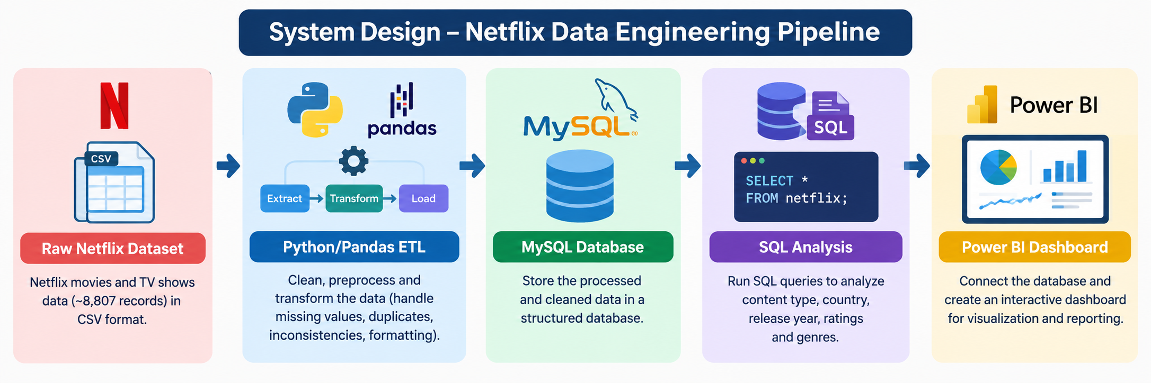
System Design

Slide 8
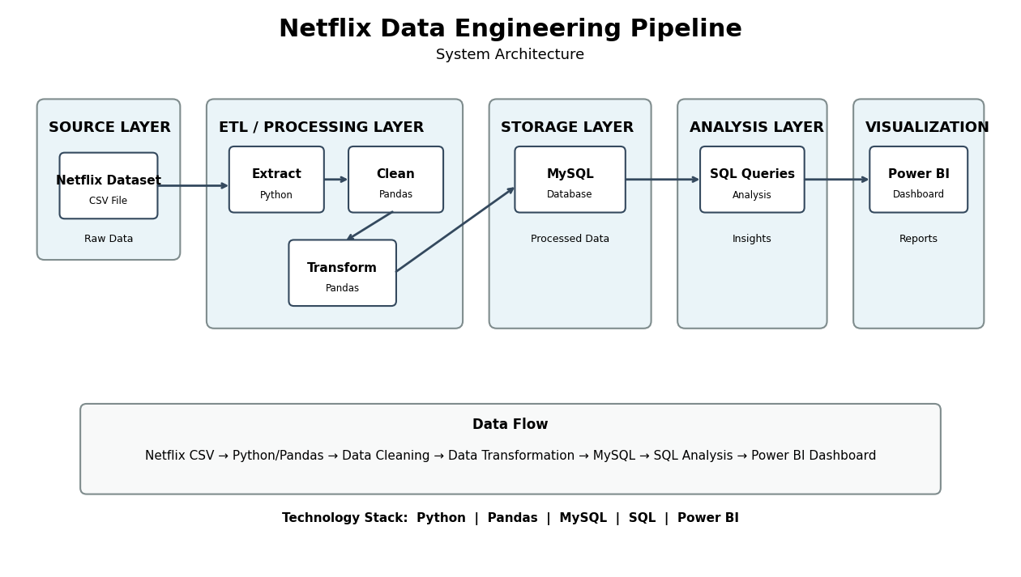
SYSTEM ARCHITECTURE

Slide 9
Use of Modern Tools and Technologies
Tool / Technology | Purpose
Python | Data processing and ETL implementation
Pandas | Data cleaning, transformation and manipulation
MySQL | Storing processed Netflix data
SQL | Querying and analyzing the database
Microsoft Power BI | Creating interactive dashboards
ETL | Overall data engineering workflow
Key Technologies
Python + Pandas → Extract, clean and transform data.
MySQL → Structured and persistent data storage.
SQL → Perform analytical queries.
Power BI → Interactive visualization of results.
These tools together support an end-to-end data engineering and analytics pipeline.

Slide 10
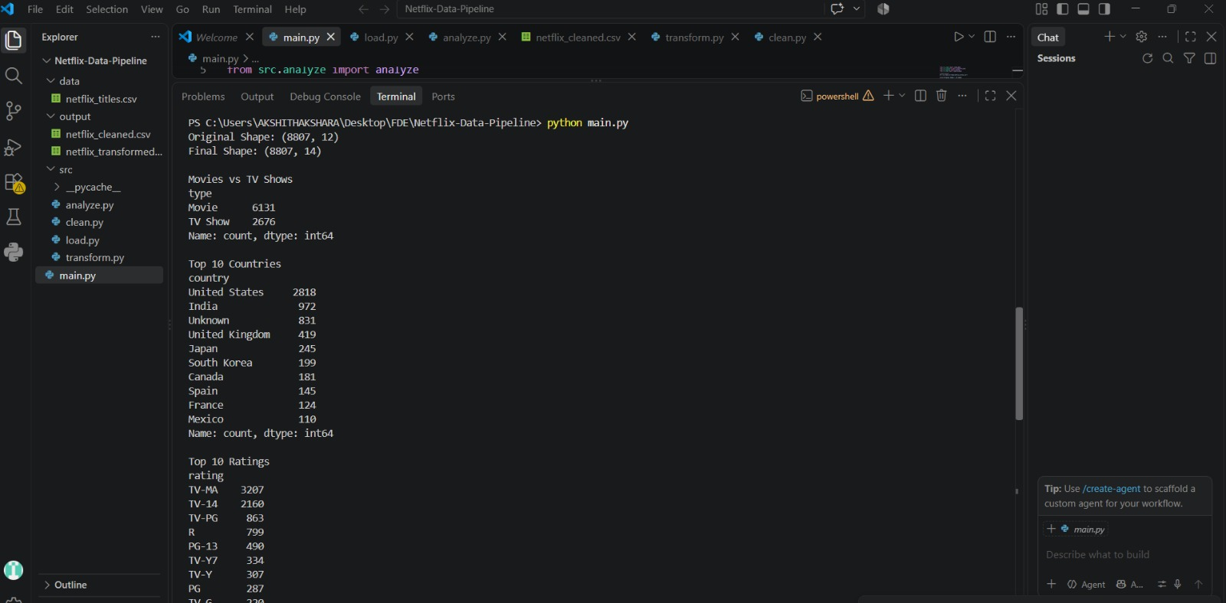
Implementation, Coding Quality, and Functionality
Implementation
Import the Netflix dataset using Python/Pandas.
Inspect the dataset for missing and inconsistent values.
Clean and transform the raw data.
Prepare the processed dataset for database storage.
Load the cleaned data into MySQL.
Execute SQL queries to generate analytical results.
Connect MySQL data to Power BI.
Build an interactive dashboard for visualization.

Slide 11
Coding Quality
Use modular and structured Python code for ETL operations.
Pandas provides efficient operations for handling tabular data.
SQL queries are used to retrieve specific analytical information.
Data validation and cleaning help maintain data consistency and quality.
The pipeline separates data processing, storage, analysis and visualization.
Functionality
The system provides analysis of:
Total number of Netflix titles
Movies vs TV Shows distribution
Country-wise content distribution
Release-year trends
Rating distribution
Genre-wise content analysis

Slide 12
EXISTING SYSTEMS
Netflix generates and stores a large amount of content-related data.
Existing platforms mainly focus on content delivery and recommendation.
Data is collected from different attributes such as:
  Movies and TV Shows
  Country
  Rating
  Release year
  Genre
Traditional analysis of raw datasets can be difficult.
Business users need dashboards to understand the data easily.

Slide 13
LIMITATIONS OF EXISTING SYSTEMS
Raw data may contain missing or inconsistent values.
Large datasets are difficult to analyze manually.
Data is not always available in a clean, structured form.
Extracting useful information from raw data requires preprocessing.
Static data makes it difficult to identify trends quickly.
Lack of a simple end-to-end pipeline connecting data processing → database → visualization.

Slide 14
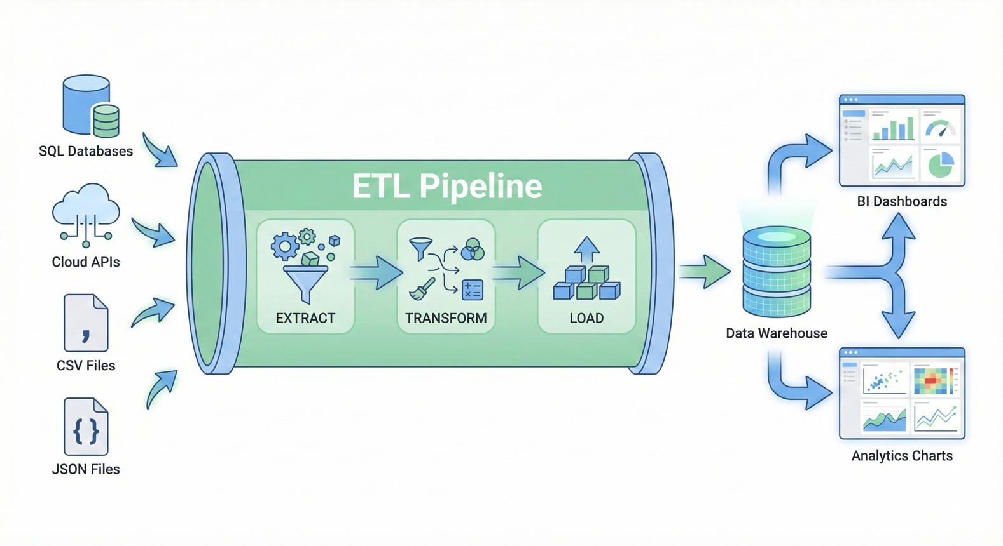
PROPOSED SYSTEM
Extract Netflix data using Python.
Clean and transform the raw dataset.
Store processed data in MySQL.
Use SQL queries for analysis.
Create interactive Power BI dashboards.
Generate meaningful insights from Netflix data.

Slide 15
SOFTWARE AND HARDWARE REQUIREMENTS
Software Requirements
Python
Pandas
MySQL
SQL
Power BI Desktop
VS Code
Operating System: Windows
Hardware Requirements
Processor: Intel i3/i5 or equivalent
RAM: 8 GB or above
Storage: 256 GB or above
Internet connection

Slide 16
FUNCTIONAL REQUIREMENTS
The system should:
Import Netflix dataset
Clean the raw data
Handle missing values
Transform data into a usable format
Store processed data in MySQL
Execute SQL queries
Generate Power BI visualizations
Display analytical insights

Slide 17
NON-FUNCTIONAL REQUIREMENTS
Performance – Process the dataset efficiently.
Reliability – Produce consistent analytical results.
Usability – Dashboard should be easy to understand.
Scalability – Pipeline should support larger datasets in the future.
Maintainability – Python and SQL code should be easy to modify.
Security – Database and project files should be protected.

